Slide 1
Computer Security
COMP6824001
Authentication, Authorization and Accounting
Session 3

Slide 2
These slides have been adapted from:
Panek, Crystal. (2019). Security Fundamental, John Wiley & Sons, Inc. Indianapolis. ISBN: 978-1-119-65066-9
Lesson 2
Acknowledgement

Slide 3
Learning Objectives
LO 1: To explain the security principles, threats, attacks and security strategy
LO 2: To evaluate different strategies to handle security threats and attacks

Slide 4
Starting Security with Authentication & Athorization

Slide 5
Security with Authentication and Authorization
Authentication is the process of identifying an individual, usually based on a user name and password
After a user is authenticated, the user can access network resources based on the user’s authorization
Authorization is the process of giving individuals access to system objects based on their identity

Slide 6
Authentication Method
What a user knows, such as a password or personal identification number (PIN)
What a user owns or possesses, such as a passport, smart card, or ID card
Who a user is, based on biometric factors such as fingerprints, retinal scans, voice input, or other forms

Slide 7
Introducing Directory Services with Active Directory

Slide 8
Directory Services with Active Directory
Directory services used for locating, managing, and administering common items and network resources
Active Directory is a technology created by Microsoft that provides a variety of network services

Slide 9
Variety Network Services in Active Directory
Lightweight Directory Access Protocol (LDAP) : application protocol for querying and modifying data using directory services running over TCP/IP
Kerberos-based authentication : Kerberos is default computer network authentication protocol, which allows hosts to prove their identity over a non-secure network in a secure manner

Slide 10
Variety Network Services in Active Directory
Directory services, including DNS-based naming : allow you to organize and name all of the network resources, including users, groups, printers, computers, and other objects
Central location for network administration and delegation of authority

Slide 11
Comparing Rights and Permissions

Slide 12
Difference Between Rights and Permissions
A right authorizes a user to perform certain actions on a computer, such as logging on to a system interactively or backing up files and directories on a system. User rights are assigned through local policies or Active Directory group policies
permission defines the type of access that is granted to an object (an object can be identified with a security identifier) or object attribute

Slide 13
NTFS (New Technology File System)

Slide 14
Understanding NTFS
NTFS (New Technology File System) permissions allow you to control which users and groups can gain access to files and folders on an NTFS volume
NTFS is part of Windows since it was first released in 1993

Slide 15
NTFS Standard Permissions
Full Control : Read, write, modify, and execute files in the folder; change attributes and permissions; and take ownership of the folder or files within
Modify : Read, write, modify, and execute files in the folder; and change attributes of the folder or files within
Read & Execute : Display the folder’s contents; display the data, attributes, owner, and permissions for files within the folder; and run files within the folder

Slide 16
NTFS Standard Permissions
List Folder Contents : Display the folder’s contents; display the data, attributes, owner, and permissions for files within the folder
Read : Display the file’s data, attributes, owner, and permissions
Write : Write to the file, append to the file, and read or change its attributes

Slide 17
Sharing Device and Folders

Slide 18
Sharing Device and Folders
Sharing devices and folders along with NTFS permission are used to protect against unauthorized access
share permissions that are available are :
Full Control : Users allowed this permission have Read and Change permissions
Change : Users allowed this permission have Read permissions and the additional capability to create or delete folders, subfolders, and subfolders and modify their attributes
Read : Users with this permission can view file and subfolder names, access the subfolders of the share, read file data and attributes, and run program files

Slide 19
Registry

Slide 20
Introducing to Registry
The registry is a central, secure database in which Windows stores all hardware configuration information, software configuration information, and system security policies
To view and manually change the registry, use the Registry Editor (Regedit.exe), which can be executed from the command prompt
Registry keys are similar to folders, which can contain values or subkeys

Slide 21
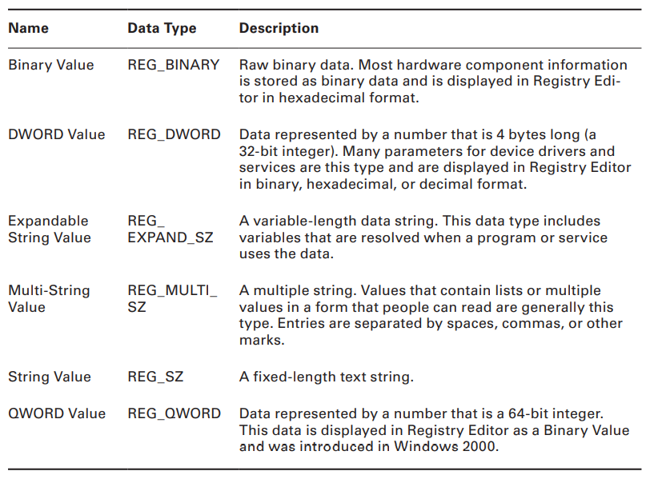
Common Registry Key Types

Slide 22
References
Text Book : Crystal Panek - Security Fundamentals-SYBEX_John Wiley & Sons (2020)

Slide 23
Some important notes in developing presentation file for online resources:
Important Notes
Please complete each presentation files with Learning Objectives information.
Please make sure to make Acknowledgement slide if you are using PowerPoint slides from textbook or the content of the slides are mainly adopted from the textbook.
If you are adding picture or information from other sources, please give reference footnote on the slide.
URL of the reference must be written in complete format, e.g. http://www.cocktailsoftheworld.com/uploads/pics/Jtho.jpeg
References slide must contain all references that have been used in the slides.

